Slide 1
Integrate All the Things: PowerApps and Microsoft Flow for Developers
Brian T. Jackett
Sr. Premier Field Engineer
Microsoft

Slide 2

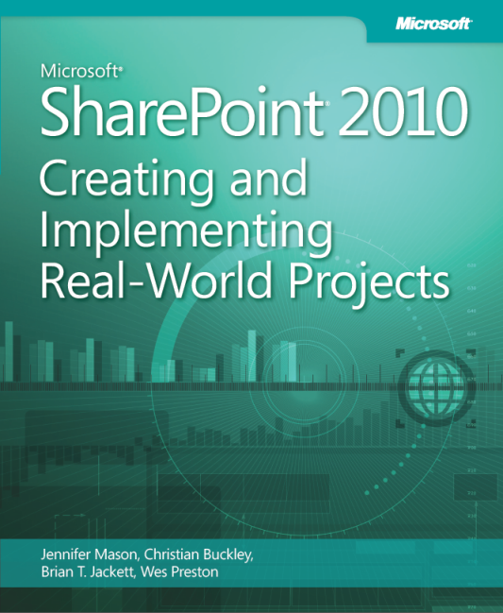
About Me
Sr. Premier Field Engineer at Microsoft
SharePoint Dev / Admin, PowerShell
Blog: www.BrianTJackett.com
Twitter: @BrianTJackett
Email: Brian.Jackett@Microsoft.com

Slide 3
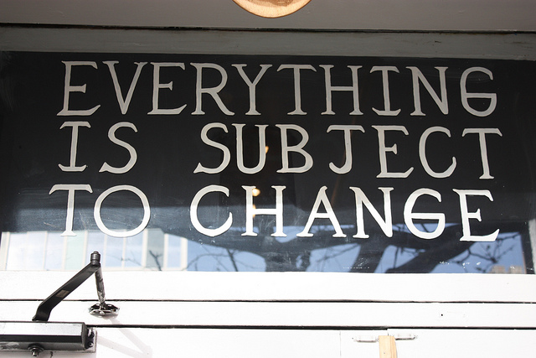

Slide 4
Session Objectives and Takeaways
Session Objectives:
PowerApps and Microsoft Flow overview and comparison
How to integrate with enterprise and consumer data sources
How to leverage custom APIs and data sources
Key Takeaways:
Expand horizon of tools and processes for interaction
Demo scenarios for when to use PowerApps / Microsoft Flow

Slide 5
Slide 5 of <44>

Slide 6

Interactive Demo for Later
Tweet: #BTJPADemo …
-or-
Instagram: #BTJPADemo

Slide 7
Agenda
PowerApps
Data Connectors
Admin Options
Dev Options
Microsoft Flow
Tips and Tricks

Slide 8

Room meet Elephant
I’m not the InfoPath / workflow replacement you are looking for… today
Notes:
Source image:
http://elephant-pictures.clipartonline.net/Cute-Female-Elephants/Cute-Elephant-Clipart_9.png

Slide 9

Why PowerApps?
SaaS apps
enterprise services
business systems
Connect across your data from the cloud to on-premises
Notes:
Getting a little bit into the “how” of PowerApps, we begin by addressing the issues and questions of Connection. How do we take the info we rely on (wherever it is, from the most modern cloud services – either sanctioned by the enterprise, or not - to the legacy on-premises business systems that have been in place for years). How do we make all these assets and services equally mobile-ready, without the pain and cost and expense of replacing or overhauling the legacy systems? PowerApps collects all of these sources and services in their current state, and makes them available to app creators.

Slide 10
Why PowerApps?
SaaS apps
enterprise services
business systems
Connect across your data from the cloud to on-premises
Create business apps with easy visual tools and powerful cloud services
Notes:
Turning to app creators, PowerApps takes that collection of data and gives everyone the ability to create and produce useful solutions that are individualized to work best for their specific objectives and working styles. And when we say “everyone” we mean across the board – from Pro Devs and IT Admins who traditionally create apps and make data available, to the business folks who usually spend their time in Office suite applications – everyone can create their own solutions using tools that they are comfortable with (including easy drag-and-drop interfaces for non-engineers).

Slide 11
Why PowerApps?
SaaS apps
mobile
enterprise services
tablet
business systems
desktop
Connect across your data from the cloud to on-premises
Create business apps with easy visual tools and powerful cloud services
Share securely with your team across devices
Notes:
Connecting data sources and creating solutions is only part of the story, though. What’s required for an app development solution to be truly effective is for users to have the ability to easily deploy and share their useful solutions across all the places, teams, and devices that will find value in them. Seen from another perspective, that all users are able to browse and discover new ideas and solutions, easily install and use them across their devices, and even modify them to make an exact fit for themselves. And all this with the security and oversight your business demands.

Slide 12
PowerApps Comparisons
PowerApps
Successor to InfoPath (Forms Services)
Microsoft Flow
Successor to Workflow Manager
Similar to If This Then That (IFTTT.com) or Zapier

Slide 13


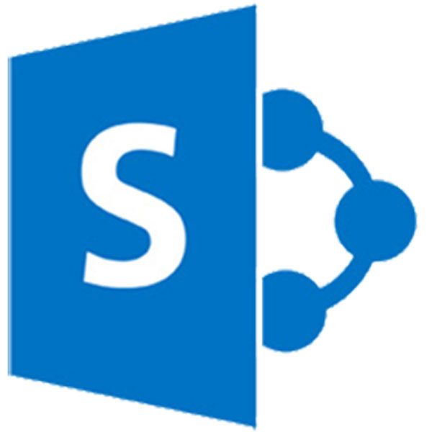




New landscape of SharePoint dev…

Slide 14
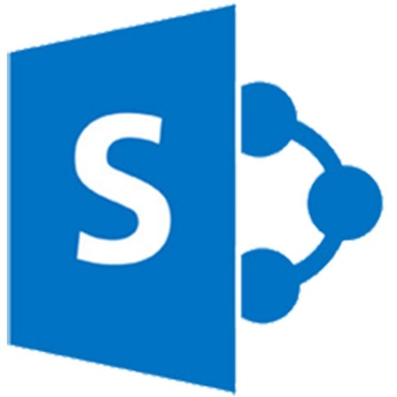





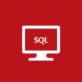
PowerApps and Flow Dev Landscape

Slide 15
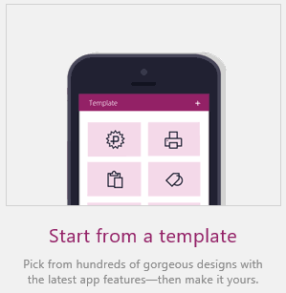
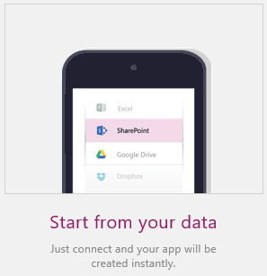
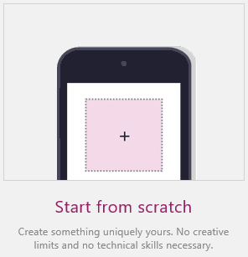
PowerApps Overview
Deployment Targets
Mobile (iOS, Android, Windows Phone, Web)
Tablet / laptop

Slide 16
Agenda
PowerApps
Data Connectors
Admin Options
Dev Options
Microsoft Flow
Tips and Tricks

Slide 17
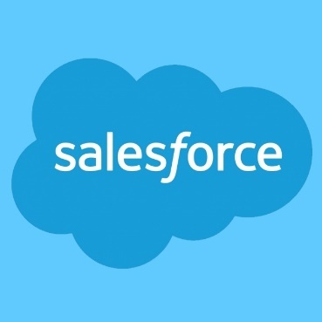


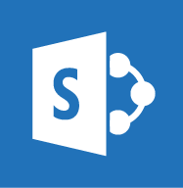
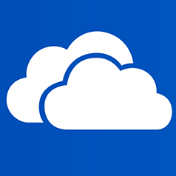
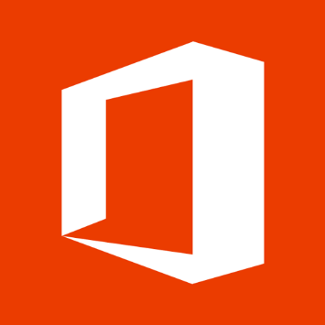









Data Connections
100+ pre-defined data sources
Notes:
Introductions of connectors was a slow ramp up but recently an explosion of new ones in the past months.

Slide 18
Data Connections
Simple CRUD operations via REST endpoints
Create
Read
Update
Delete

Slide 19
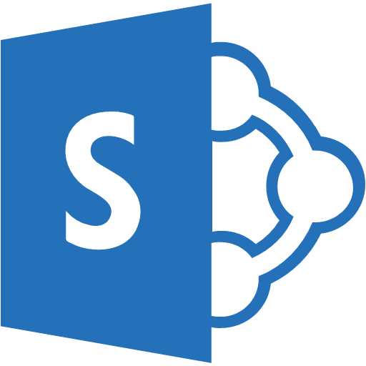


Demos
PowerApps + SharePoint
Gateway
Microsoft Flow
Super Special Demo
??

Slide 20
PowerApps + SharePoint
Added to new SharePoint List experiences
Essentially a “view” on the list

Slide 21
Agenda
PowerApps
Data Connectors
Admin Options
Dev Options
Microsoft Flow
Tips and Tricks

Slide 22


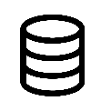

Environments
Separate data, apps, and flows
Contoso Corp.
Dev
Dev
Dev
Test
b
b
Test
b
Contoso Australia
Test
Contoso Australia
Contoso Australia
b
b
b
Prod
Contoso Australia
Prod
Contoso Australia
Prod
Contoso Australia
Contoso Canada
Contoso Canada
Contoso Australia
Contoso USA
Contoso Canada
Apps
Flows
CDM
Apps
Flows
CDM
Apps
Flows
CDM
Apps
Flows
CDM
Apps
Flows
CDM
Apps
Flows
CDM
Apps
Flows
CDM
Apps
Flows
CDM
Apps
Flows
CDM
Roadmap is for general information purposes only and subject to change
Notes:
https://powerapps.microsoft.com/en-us/blog/building-a-custom-api-for-powerapps-using-azure-app-service-web-apps/
*Swagger rebranded as Open API Definition Format (OADF) and now rebranded again to OpenAPI Specification (OAS)
https://openapis.org/news/announcement/2015/11/new-collaborative-project-extend-swagger-specification-building-connected
https://openapis.org/news/blogs/2016/01/next-steps-oai-exciting-2016-looms-ahead

Slide 23
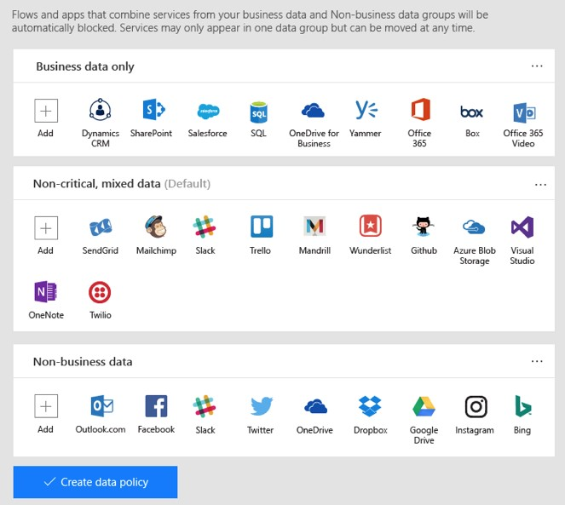
Data Policies
Categorize data
Business data only*
Mixed data
Non-business data*
* = Can’t mix these categories
(*) Capabilities planned for Post GA release
Roadmap is for general information purposes only and subject to change

Slide 24
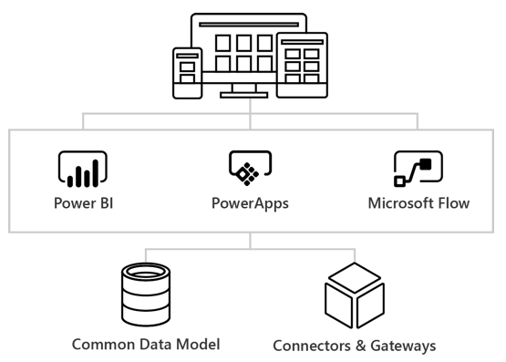
On-Premises Data Gateway
Connect to on-prem data
Same technology used by Power BI, PowerApps, and MS Flow
Notes:
https://powerapps.microsoft.com/en-us/tutorials/gateway-reference/

Slide 25

On-Premises Data Gateway
Supports…
SQL Server
SharePoint
Oracle
DB2
Filesystem
…
Tips
Can’t install on domain controller

Slide 26
Sharing PowerApps
Azure Active Directory based
Name or email
Permissions are user (execute) or contributor (full control)
No personal accounts… today
Separate data connections
Target user leverages their own data connection
Prompted for choice when launching app
Notes:
AAD basis means (typically) no personal accounts but instead work accounts. Also cannot share outside of your AAD… today. That may change in the future.

Slide 27
Demos
SharePoint + PowerApps
Gateway
Microsoft Flow
Super Special Demo
??

Slide 28
Agenda
PowerApps
Data Connectors
Admin Options
Dev Options
Microsoft Flow
Tips and Tricks

Slide 29

Custom API
Define your own API
Swagger-based
Connect to data sources not already defined
LOB app
Internal Web API
Etc.
Swashbuckle (NuGet)
Convert existing API Controller to Swagger document
Tip: Uncomment “EnableSwaggerUI” in SwaggerConfig.cs
Notes:
https://powerapps.microsoft.com/en-us/blog/building-a-custom-api-for-powerapps-using-azure-app-service-web-apps/
*Swagger rebranded as Open API Definition Format (OADF) and now rebranded again to OpenAPI Specification (OAS)
https://openapis.org/news/announcement/2015/11/new-collaborative-project-extend-swagger-specification-building-connected
https://openapis.org/news/blogs/2016/01/next-steps-oai-exciting-2016-looms-ahead

Slide 30
Custom API
Export from Azure API App
Authentication
None
Basic
OAuth 2.0
Custom API Limits
Office 365 user | PowerApps Plan 1 or 2 user
1 | Unlimited

Slide 31
Common Data Service
Organizational database in the cloud
Entities define domain language
People = Employee, Team, Contractor…
Sales = Customer, Contact, Sales Order…
Able to define custom entities
Create relationships between entities
Id | Title | CustomerId | OrderId
CustomerName | Locale | CustomerId
OrderId | OrderDate | Price
Notes:
https://powerapps.microsoft.com/en-us/tutorials/data-platform-intro/

Slide 32
Agenda
PowerApps
Data Connectors
Admin Options
Dev Options
Microsoft Flow
Tips and Tricks

Slide 33

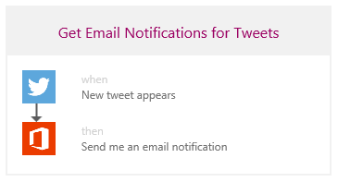
Microsoft Flow
Previously called Logic Flows
Simplified version of Azure Logic Apps
Rich workflows connected to services
Conditional logic
Templates -or- from scratch

Slide 34
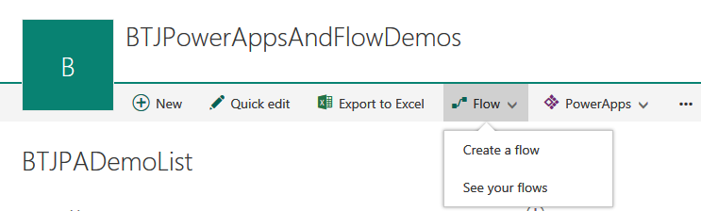
Microsoft Flow
SharePoint Integration
Connect to a SharePoint List

Slide 35
Microsoft Flow
Trigger examples
Recurrence
PowerApps control selected
File / email / contact created
Action examples
Create file / event / contact
Send email / tweet

Slide 36
Demos
PowerApps + SharePoint
Gateway
Microsoft Flow
Super Special Demo
??

Slide 37
Microsoft Flow
Examples
Create file on reoccurring schedule

Slide 38
Demos
PowerApps + SharePoint
Gateway
Microsoft Flow
Super Special Demo
??

Slide 39
Super Special Demo
http://aka.ms/BTJPADemo
Flow – Capture Twitter Hashtag #BTJPADemo
Flow – Insert Azure SQL DB record
Azure Web App – EF Model display DB data
Azure API App – EF Model of DB Data + Swagger
PowerApps – Custom API from Azure API App
PowerApps – App displays data via Custom API
Flow – Perform sentiment analysis
Power BI – Visualize sentiment analysis to dataset

Slide 40
Agenda
PowerApps
Data Connectors
Admin Options
Dev Options
Microsoft Flow
Tips and Tricks

Slide 41
Tips and Tricks
Don’t use spaces in column names (blah_x0020_blah)
Duplicated connections from Microsoft Flow
Account connected to source

Slide 42
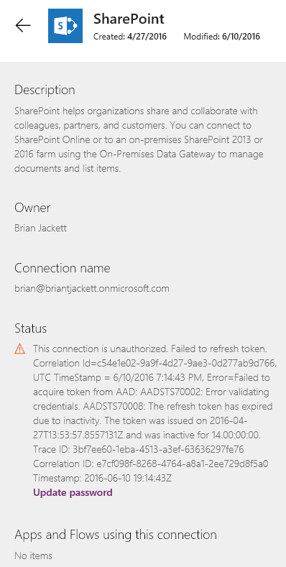
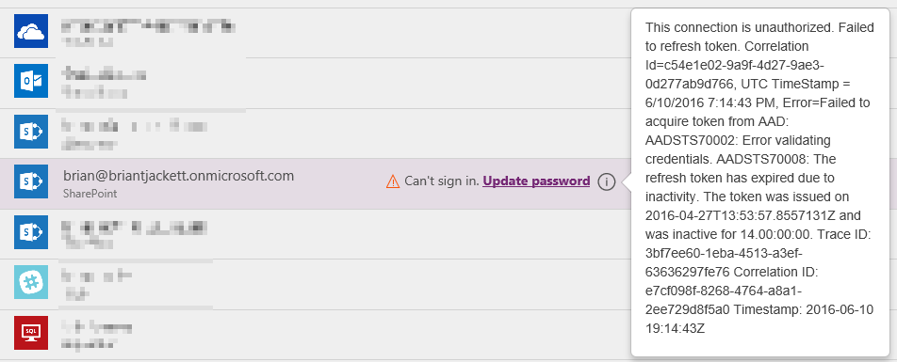
Tips and Tricks
Keep passwords in connections updated
Notes:
Notice the bottom of details screen for which apps or flows are using this connection.

Slide 43
In Review: Session Objectives and Takeaways
Session Objectives:
What are (and what aren’t) PowerApps and Microsoft Flow
How to integrate with enterprise and consumer data sources
How to leverage custom APIs and data sources
Key Takeaways:
Expand horizon of tools and processes for interaction
Demo scenarios for when to use PowerApps / Microsoft Flow

Slide 44

Q&A Credits: Icons from Microsoft Azure Cloud and Enterprise Symbol / Icon Set from http://aka.ms/azureicons

